Slide 1
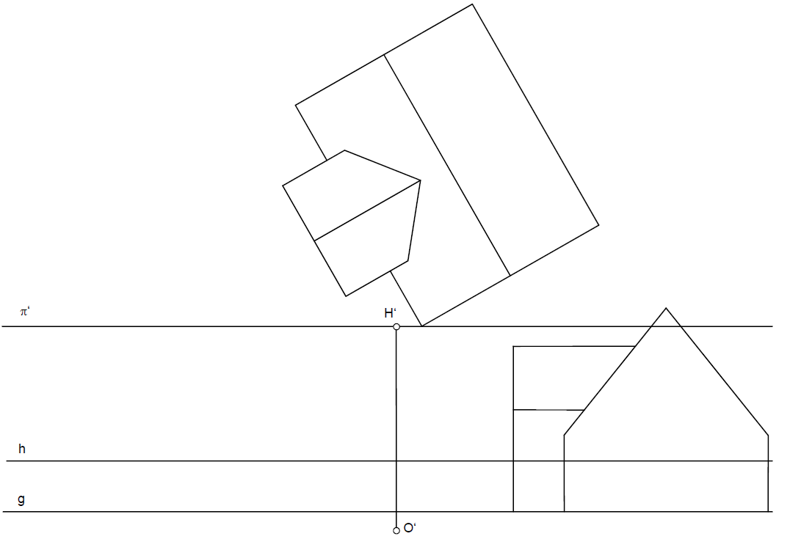


$$F_{2}$$
$$F_{1}$$

Slide 2
$$F_{2}$$
$$F_{1}$$

Slide 3
$$F_{2}$$
$$F_{1}$$

Slide 4
$$F_{2}$$
$$F_{1}$$

Slide 5
$$F_{2}$$
$$F_{1}$$

Slide 6
$$F_{2}$$
$$F_{1}$$

